Slide 1
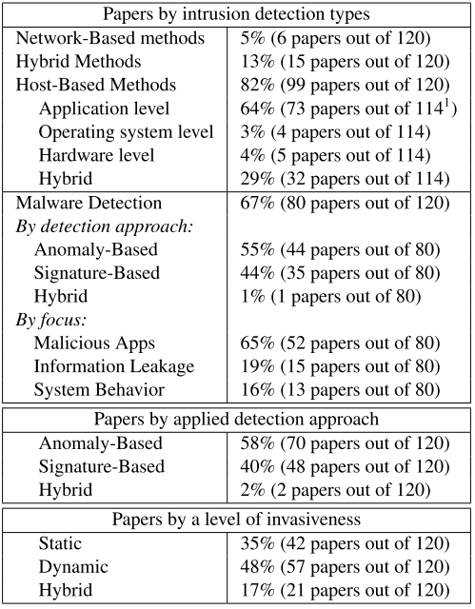
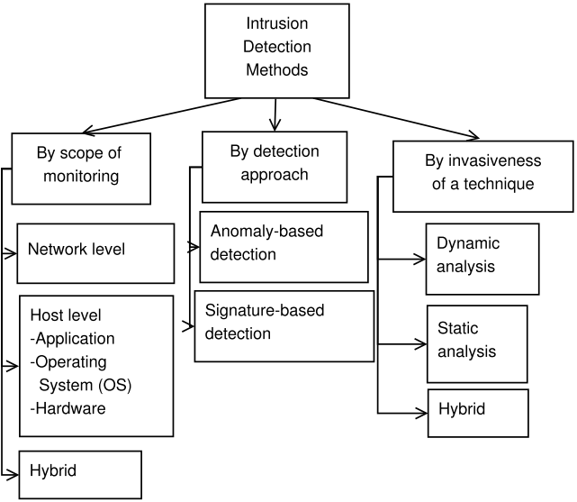
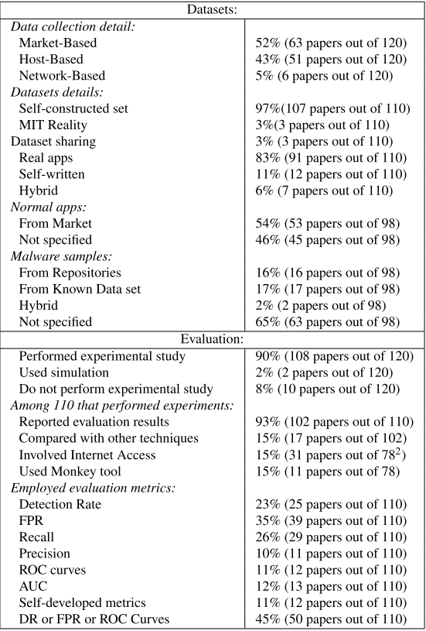
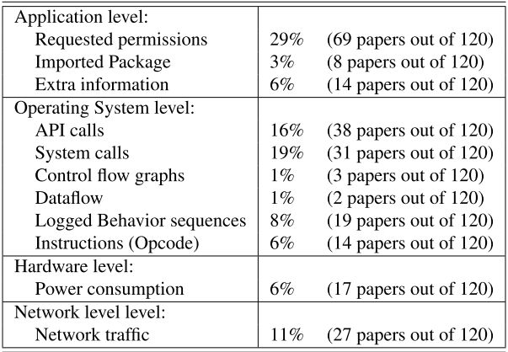
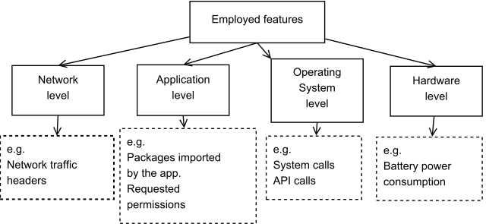
Characterizing Evaluation Practices of Intrusion Detection Methods for Smartphones
Abdullah Alzahrani, Natalia Stakhanova, Hugo Gonzalez, and Ali A. Ghorbani
Faculty of Computer Science, University of new Brunswick
Our Work
Overview of the reviewed studies
We investigated the employed experimentation practices adopted by the smartphone security community through a review of 120 studies published during the period between 2008 - 2013.
Our contributions:
An overview of the research in the ﬁeld of smartphone’ intrusion detection techniques.
Analysis of the deﬁciencies of the existing experimentation practices.
A set of guidelines that could help researchers to avoid common pitfalls and improve the quality of their work.
We classify the intrusion detection research following these categories:
Trends
Detailed Survey Observations
The interest in application-level detection has been steadily increasing and in 2013 the proportion of studies with this scope reached 64%.
Datasets
The transparency of a dataset
Customized datasets require collecting & preprocessing data.
Unless these activities are fully described and the dataset made available, there is little assurance that a dataset will be representative of a deployment environment
The lack of standardized datasets available to researchers
Among the reviewed studies only three papers made datasets publicly available
The feasibility of the comparative analysis
variability of customized data makes comparative analysis of techniques challenging
The selection of features
A set of features is a basis for analysis
We extracted 188 unique features used in the reviewed papers
Experimentation
The details of experimental setup and the employed methodology are necessary to ensure repeatability of the experiments and therefore to facilitate the comparison between techniques.
Our survey shows most of the researchers neglect to include these details in the study description.
A arise of alternative Android app markets, (known for their lack of security checks)
Employed Features

